Slide 1
Cross pollination
Risk sharing

Slide 2

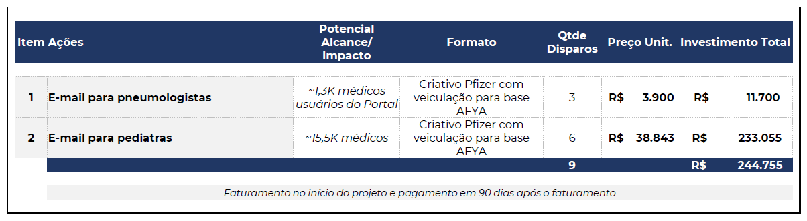
Risk sharing: new ways of negotiating with external partners
Objective: expand Cuidando do Futuro reach and bring access to PfizerPro pages
AFYA’s proposal to send our e-mails to their database – Avg %OR 28% & %CTR 1% - 10% OVERLAP vs Pfizer database
Cost per email sent:
PNEU: R$ 3,00
PED: R$ 2,50
Charge on #e-mails sent
Pfizer counter-proposal:
1. No justification for cost per PNEU email be higher than PED e-mails. Both should be R$2,50
2. The effort of sending 100 or 100M e-mails is the same – no justification to charge per e-mails sent
3. Risk sharing: payment based on %OR with rules:
If %OR is ≤ Avg 28% = ~R$58k;
If %OR is > 28% = Charge according to %OR. Ex: OR 35% = ~ R$85k
If %OR is 100% (max possible) = Pfizer pays R$ 242k

Slide 3
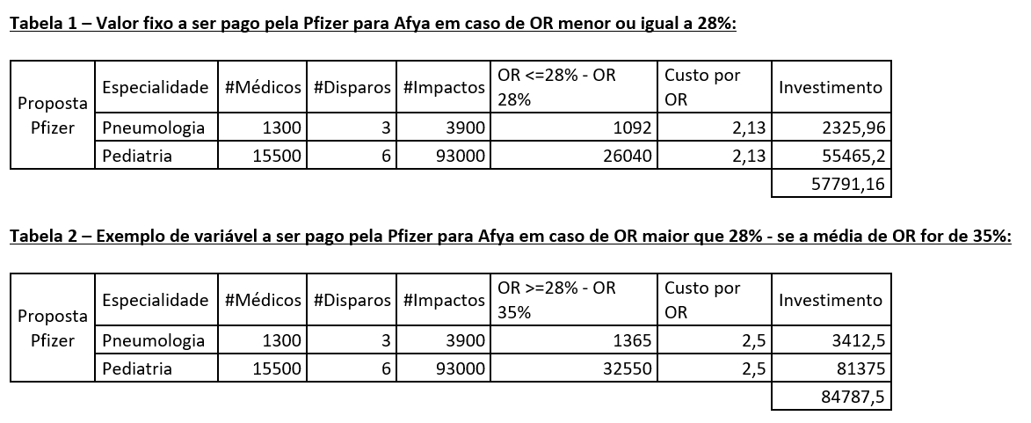
Análises

Slide 4
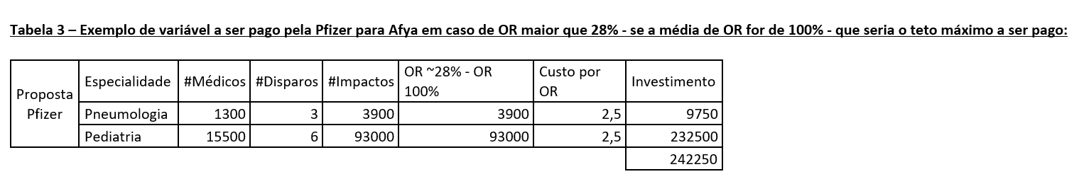
Análises

